Slide 1
How much are people talking about depression within r/Narcolepsy?
By: Dustin Luchmee

Slide 2
Table of contents
01
02
03
Problem
Solution
Discussion
In social media forums, much information is shared between users. When a topic is of major interest, it is highly discussed. One major struggle narcoleptics face is mental health.
By using TF-IDF, we can learn about what concerns people with narcolepsy have and by using cosine similarity, understand the user activity (posts/comments).
What did we learn from applying these techniques and how may they help narcoleptics? What future directions can we take?

Slide 3
The Problem
In a forum, how many posts and comments focus on depression?

Slide 4

The pitfalls of patient forums
Patient forums are LOADED with information. As an epileptic, I have used patient forums to learn about medications, diet, and lifestyle changes I can make to improve my neurological health.
Many people with narcolepsy struggle with depression. Because of this, I was curious as to how many posts and comments within the r/Narcolepsy forum are centered around depression.
By learning about how frequent discussions are about depression, we can better understand the rate of depression in narcoleptics.

Slide 5
—Community Member
“I’m on a constant emotional roller coaster depending on how well
my symptoms are being handled.”

Slide 6
The Solution
How can we learn about depression from posts and comments?

Slide 7


How can we use NLP to help?
TF-IDF
Cosine Similarity
Term frequency-inverse document frequency is a statistical measure that evaluates how relevant a word is to a document in a collection of documents. This is done by multiplying how many times a word appears in a document, and the inverse document frequency of the word across a set of documents.
Cosine similarity measures the similarity between documents, regardless of the size of each document. This could be very useful for taking a particular document, our in our case a post or comment thread, and identifying content that is similar.

Slide 8

Why TF-IDF?
TF-IDF is simple and computationally cheap.
Allows for us to do similarity calculations.
Is a well known technique with applications for social media and healthcare.
Allows us to learn about comment content within posts/comments.
Can be done with Scikit-Learn!

Slide 9
The Process
01
02
03
04
Analysis
Data Cleaning
We want to learn about what content is most common in our documents.
We don’t want to output ‘garbage’. We must clean our data to get it ready for analysis!
Reflection
Visualization
What do these results mean? What are some future directions for this project?
WordClouds let us see what topics and concerns are shared in r/Narcolepsy

Slide 10

Data Cleaning and Preprocessing

Slide 11
Data Cleaning
Without data cleaning, we are at risk of getting unreliable and poor results. For cleaning and preprocessing, I began lowercasing the data as capitalized and lowercase letters are treated differently. Second, I removed digits and words containing digits in the two data columns I was interested in: Post and Comments. This was done as numbers may appear for medication dosages, which on their own do not have much meaning. However, if I was specifically looking to learn more about how much medication patients are taking and the impacts of those drugs, I would not remove the digits and would instead transform them to textual representations. Third, I removed punctuations, extra spaces, and stopwords as these can cause words that are not meaningful to appear in our analysis. Lastly, I chose to lemmatize the text in both the post and comment columns as it gives meaningful representation of a word and provides for higher accuracy for content analysis.
One could also remove contractions and emoticons. However, this did not seem to be a large problem with the small dataset that we have.
One challenge in preprocessing is the amount of null values. Because there were so many null values, dropping them was not possible. I opted to use the two data columns with the most content: Post and Comments. The column Unnamed were replies, which some members were very active and others were not. Moving forward, I would look to scrap as much data from the replies and drop null values, but had not found the best approach to do so.

Slide 12

Data Analysis

Slide 13
Data Analysis : TF-IDF
Our TF-IDF matrix gives the output of the relevancy of a word within a document. Some of the words that we extracted as features through TF-IDF performed on posts and comments in r/Narcolepsy included references to medications such as antidepressants, stimulants, and brand name medications such as Xyrem and Modafinil.
'able' 'actually' 'adderall' 'adjust' 'advice' 'affect' 'ago' 'alert'
'amp' 'antidepressant' 'anxiety' 'anxious' 'anymore' 'anytime' 'anyways'
'apnea' 'apparently' 'appetite' 'apply' 'appreciate' 'approve' 'ask'
'asleep' 'assume' 'attack' 'average' 'avoid' 'awake' 'away' 'awful' 'bad'
'ball'

Slide 14
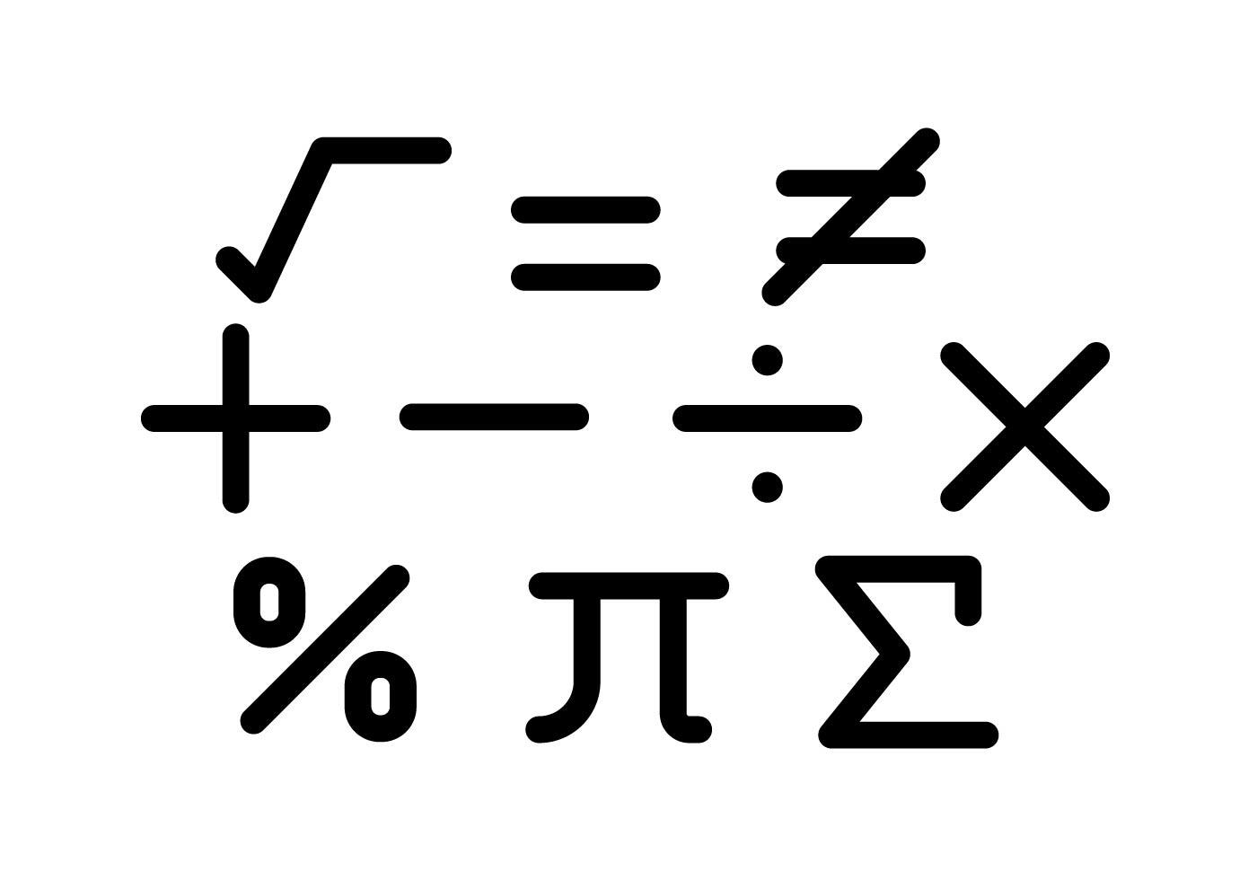
Data Analysis : Cosine Similarity
Cosine similarity was performed on the posts and comments separately. Because the vectors were not the same size, they could not be compared against each other.
Cosine similarity revealed that the content within post and comment threads were diverse, as further demonstrated using word clouds.
The closer the cosine values were to 1, the similarity between two vectors or two posts/content pieces was greater.

Slide 15

Data Visualization

Slide 16
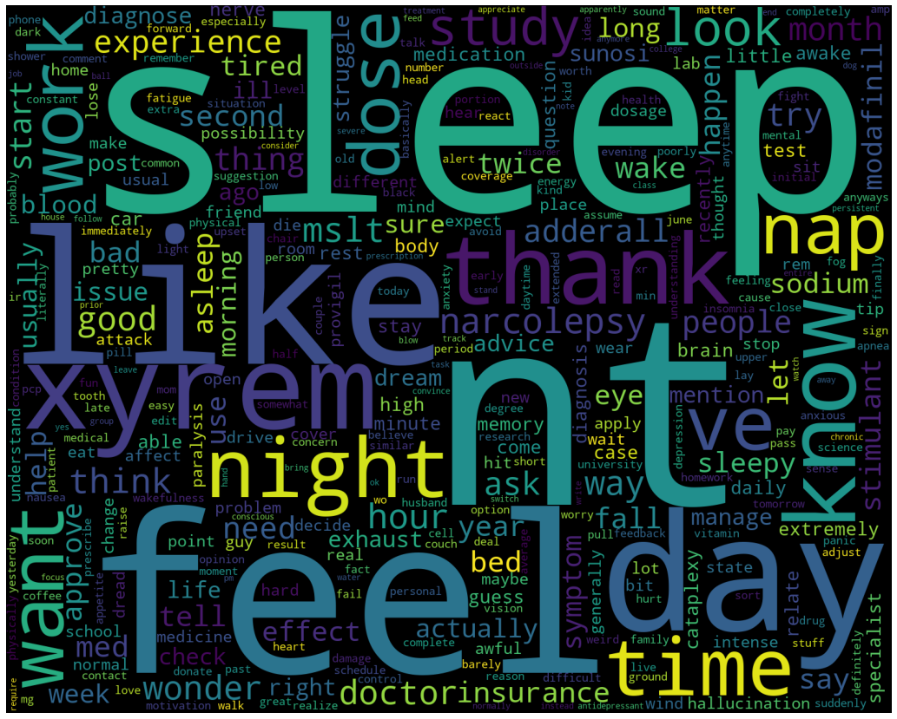
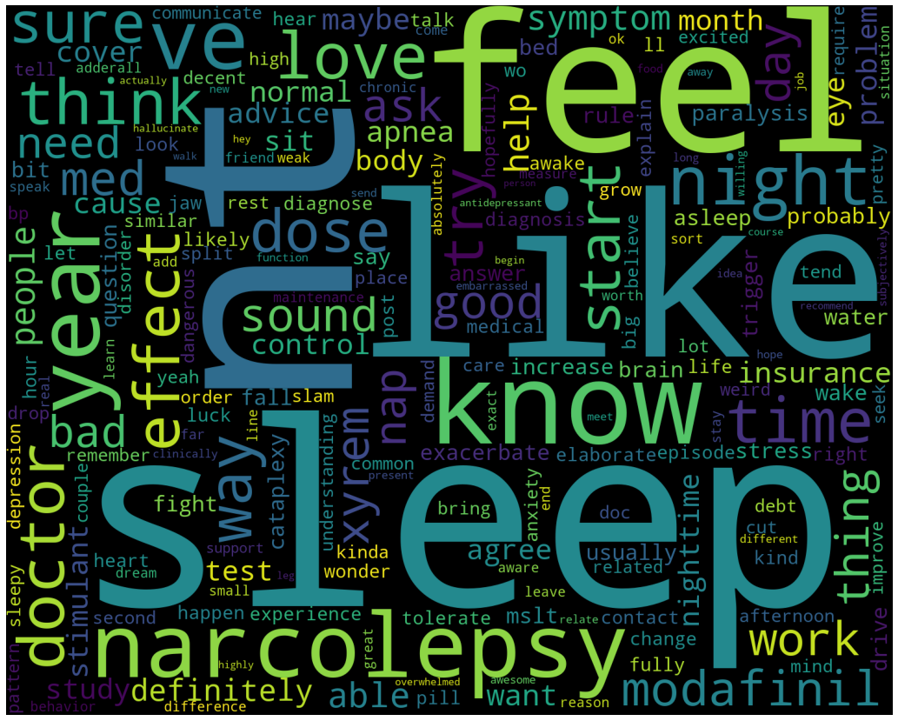
WordClouds for Posts and Comment Threads
Posts
Comments
Content in the posts appeared to focus on sleep and sleep medication.
Comments focused on sleep, but mentioned more of the psychological impacts of narcolepsy.

Slide 17
Discussion
What did we learn about depression from the content of/between posts and comments?

Slide 18

What did we learn?
Most common words used in both the post and comment threads pertained to sleep. However, sleep medications were mentioned more frequently in the posts in comparison to stimulant medications mentioned in the comments.
Despite having many common words, posts and comments within this community are different from each other.
Patients in this forum seem to discuss psychological well-being, everyday functioning (work), and the consultation of medical professionals.
Brand name medications mentioned include Xyrem, Modafinil, and Adderall.
People talk about depression, medication use, triggers, hallucinations, and troubles with work and school.
Notes:
In the data set, we were able to query 10 posts and 10 comments about depression (20% of each document). If we were able to include all of the commenters, we may have a larger amount.

Slide 19

Next Steps
Figure out a way to handle low engaged individuals, as these interactions generate many null values that made using data from replies very difficult.
Try Word2Vec to learn about word associations within posts/comments/replies
With a larger sample of data and more information, we could do classification of helpful comments and posts regarding depression within this thread using a multilayer perceptron model and then analyze the content of those documents using TF-IDF.

Slide 20
Thanks!
Do you have any questions?
dustin.luchmee@protonmail.com
+1 610 209 8474
https://www.linkedin.com/in/dustin-bryce-ellis-luchmee/

